Slide 1


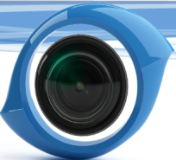
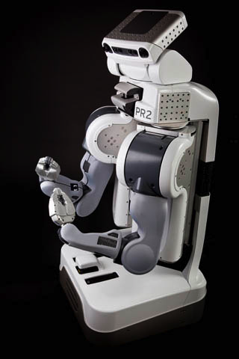
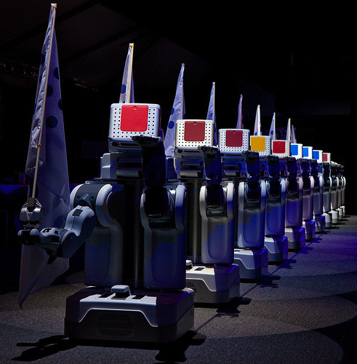
OpenCV Tutorial
Itseez
Victor Eruhimov
Itseez, CTO
http://opencv.willowgarage.com
www.willowgarage.com
www.itseez.com

Slide 2
Outline
OpenCV Overview
Cheatsheet
Simple Programs
Tour
Features2D
Applications

Slide 3
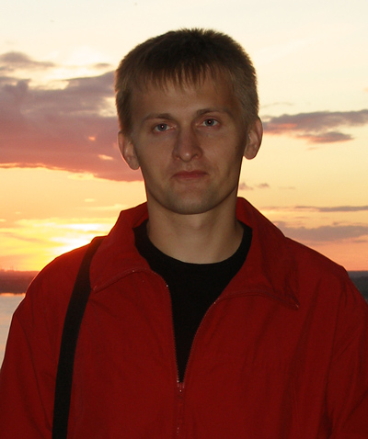
OpenCV Czar

Slide 4
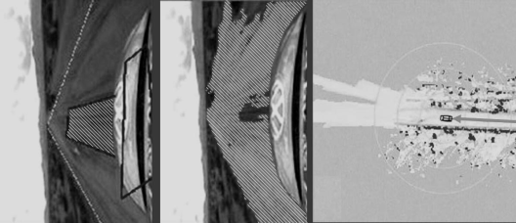
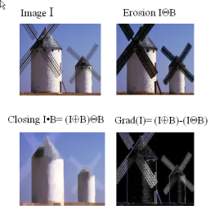
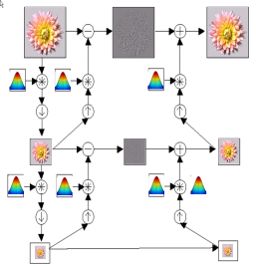
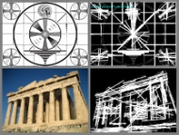
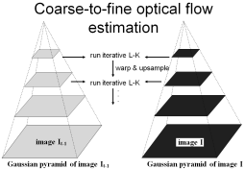
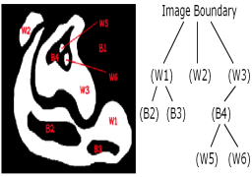
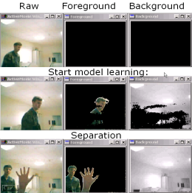
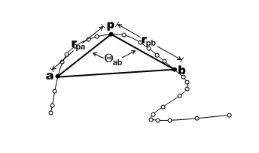
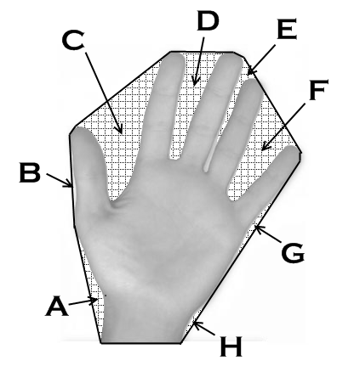
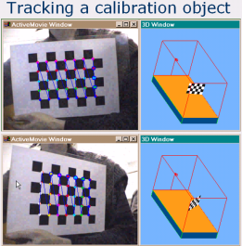
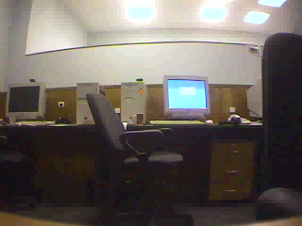
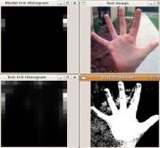
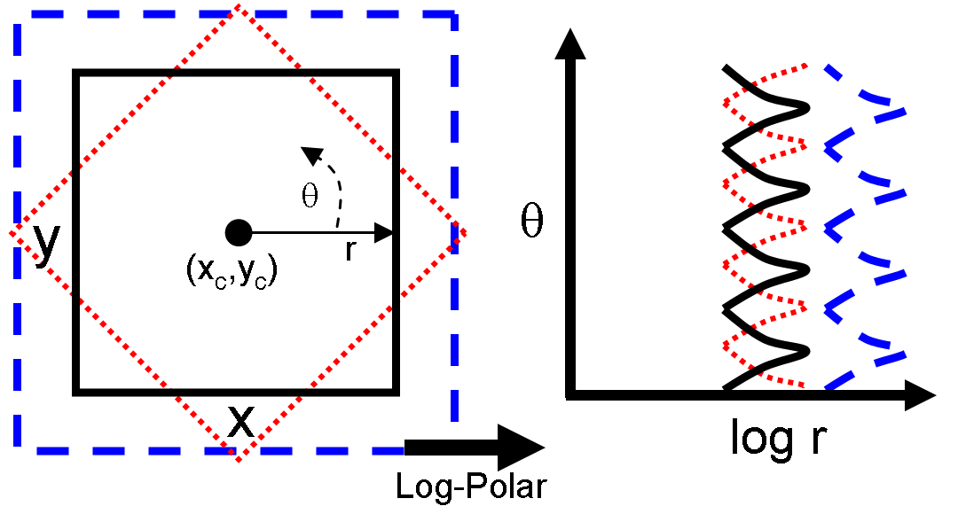
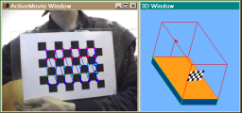
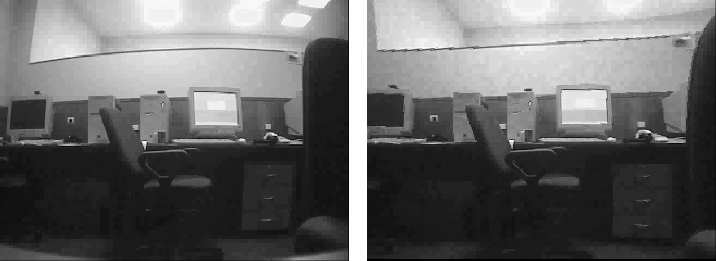
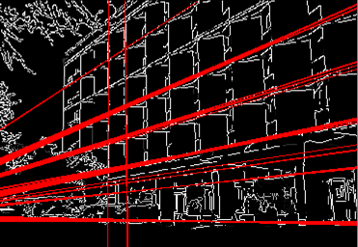
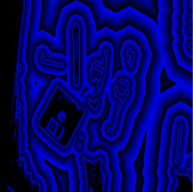
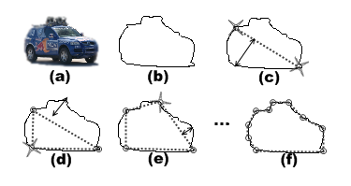
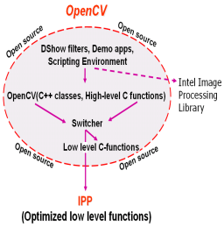
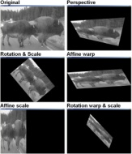
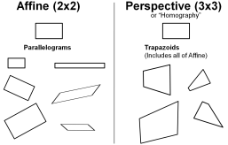
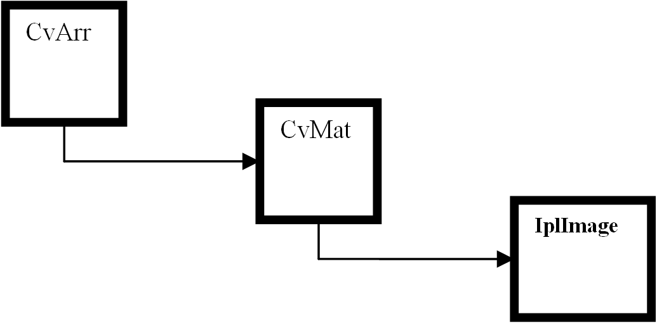
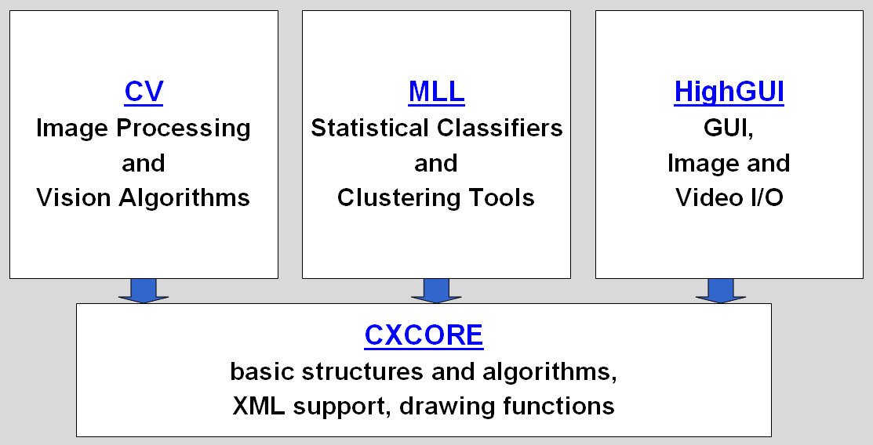
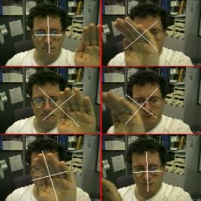
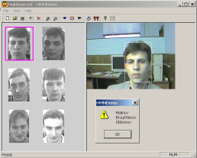
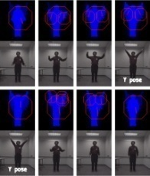
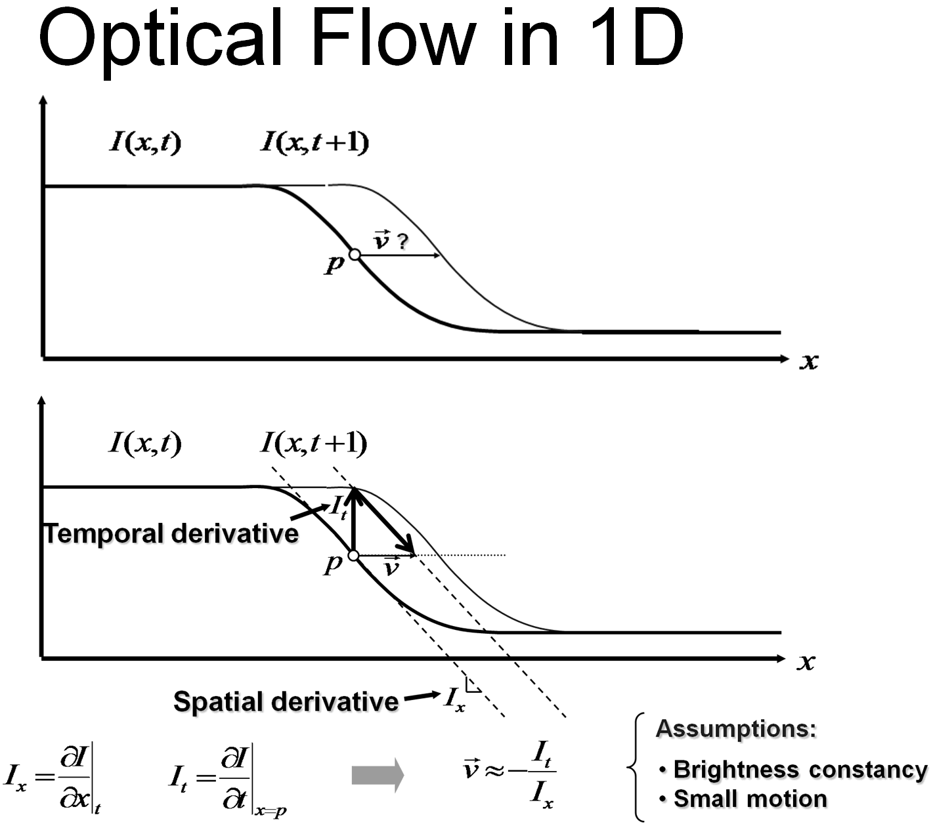
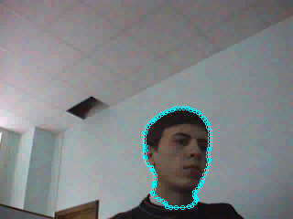
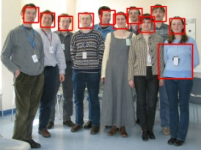
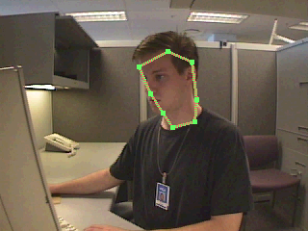
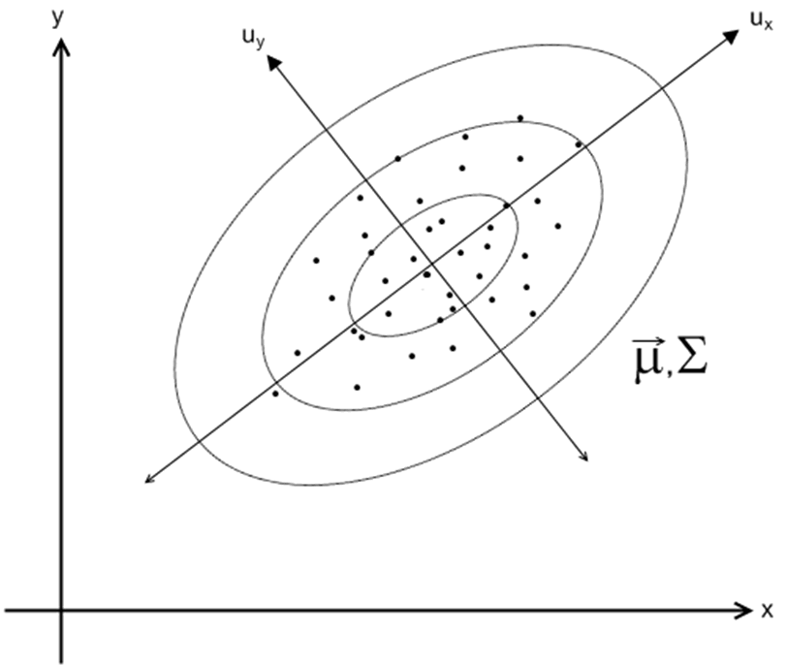
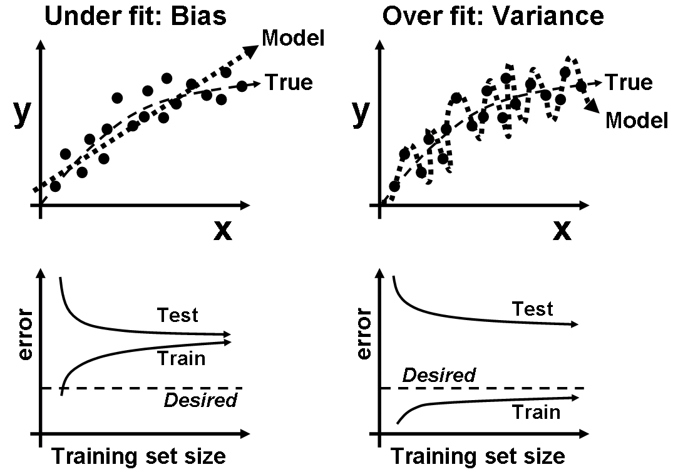
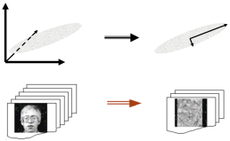
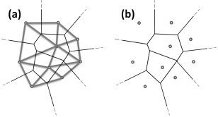
OpenCV Overview:
Robot support
opencv.willowgarage.com
> 500 algorithms
General Image Processing Functions
Image Pyramids
Geometric
descriptors
Segmentation
Camera
calibration,
Stereo, 3D
Features
Transforms
Utilities and
Data Structures
Tracking
Machine Learning:
Detection,
Recognition
Fitting
Matrix Math

Slide 5
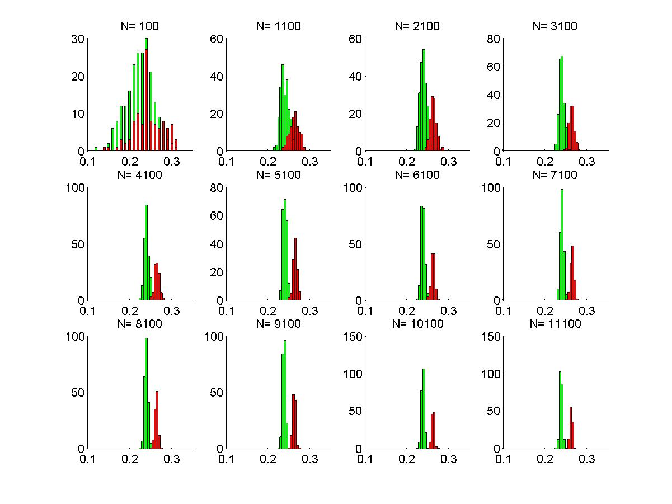
Machine Learning Library (MLL)‏
CLASSIFICATION / REGRESSION
(new) Fast Approximate NN (FLANN)
(new) Extremely Random Trees
CART
Naïve Bayes
MLP (Back propagation)‏
Statistical Boosting, 4 flavors
Random Forests
SVM
Face Detector
(Histogram matching)‏
(Correlation)‏
CLUSTERING
K-Means
EM
(Mahalanobis distance)‏
TUNING/VALIDATION
Cross validation
Bootstrapping
Variable importance
Sampling methods
AACBAABBCBCC
AACACB
CBABBC
CCB
AAA
CB
ABBC
CC
B
C
B
A
BBC
BB
C
http://opencv.willowgarage.com
5
Notes:
5

Slide 6
OpenCV History
Original goal:
Accelerate the field by lowering the bar to computer vision
Find compelling uses for the increasing MIPS out in the market
Timeline:
Staffing:
Climbed in 1999 to average 7 first couple of years
Starting 2003 support declined between zero and one with exception of transferring the machine learning from manufacturing work I led (equivalent of 3 people).
Support to zero the couple of years before Willow.
5 people over the last year
Willow
Beta 1 Release, support for Linux
Alpha Release at CVPR’00
Beta 2 Release
Beta 3 Release
Beta 4 Release
OpenCV Started
Beta 5 Release
Release 1.0
Release 1.1
Release 2.0
1999
2000
2001
2002
2003
2004
2005
2006
2007
2008
2009
2010
10
5
0
6

Slide 7
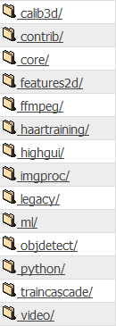
New Directory Structure
Re-Organized in terms of processing pipelines
Code site: https://code.ros.org/gf/project/opencv/
Core
Calibration, features, I/O, img processing
Machine Learning, Obj. Rec
Python
~2.5M downloads

Slide 8
OpenCV Conceptual Structure
User Contrib
Modules
Other
Languages
Object
Detection
Features2d
Calib3d
Stereo
VO
SLAM
(TBD)
Stitching
(TBD)
SSE
TBB
GPU
MPU
Java (TBD)
Python
Machine learning
imgproc
C++
HighGUI
CORE
C
Operating system

Slide 9
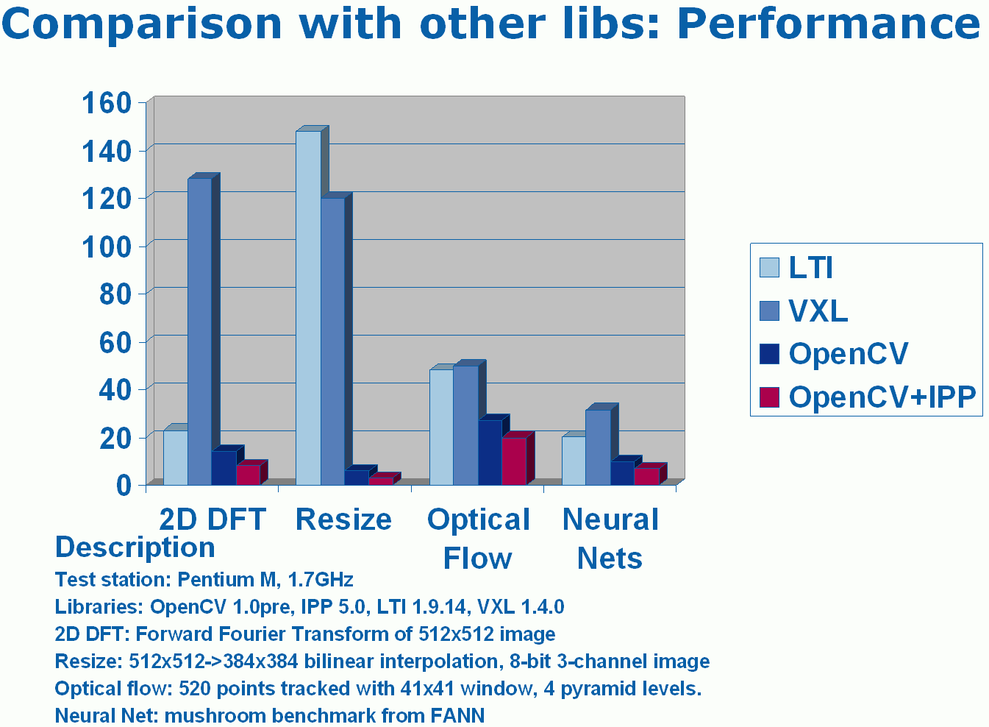
OpenCV Tends Towards Real Time
http://opencv.willowgarage.com

Slide 10
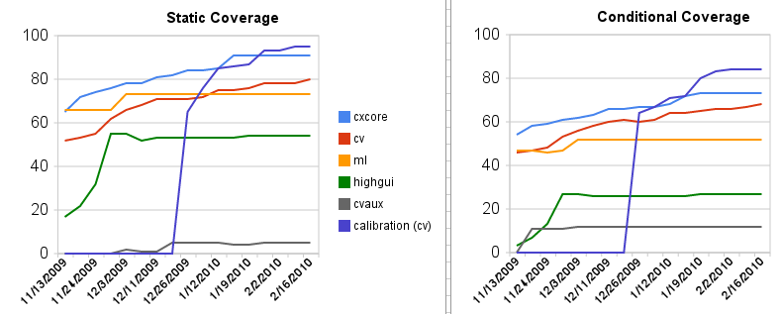
Software Engineering
Works on:
Linux, Windows, Mac OS
Languages:
C++, Python, C
Online documentation:
Online reference manuals: C++, C and Python.
We’ve been expanding Unit test code
Will soon standardize on cxx or Google’s test system.
TEST COVERAGE:

Slide 11
License
Based on BSD license
Free for commercial or research use
In whole or in part
Does not force your code to be open
You need not contribute back
We hope you will contribute back, recent contribution, C++ wrapper class used for Google Street Maps*
* Thanks to Daniel Filip
Gary Bradski (c) 2008
11

Slide 12
What’s added in December 2010 OpenCV 2.2?
Detector/Descriptor pipeline (Features2D)
Many supporting detectors and descriptor features
Easy interface to Pascal VOC
BOW and Latent SVM classification engines
Experimental User Contrib
Focus detector?
Visualization (“HighGUI”) will be based on Qt
Official support of Android OS
Updated FLANN library
Limited Cuda support (stereo)

Slide 13
What’s in Progress?
GPU support throughout the library
More functionality in features2d
Better pose estimation algorithms
ePnP
Stereo pose estimation
Circles pattern detector
Better support of Android
Support for google test

Slide 14
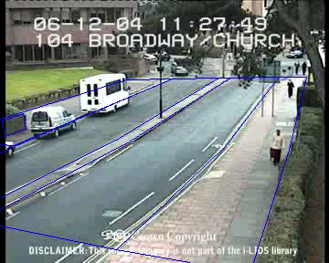
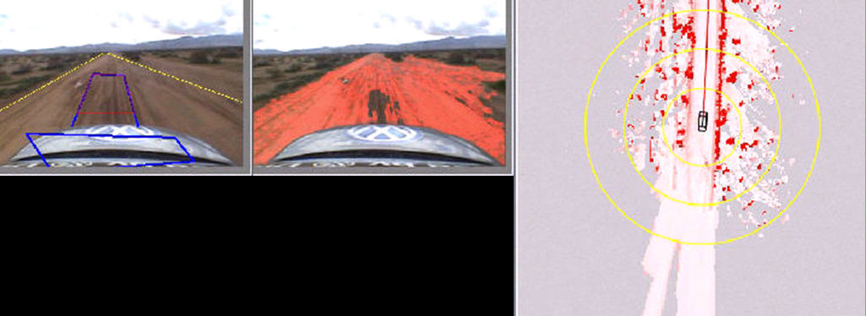
Where is OpenCV Used?
Google Maps, Google street view, Google Earth, Books
Academic and Industry Research
Safety monitoring (Dam sites, mines, swimming pools)
Security systems
Image retrieval
Video search
Structure from motion in movies
Machine vision factory production inspection systems
Robotics
Well over 2M downloads
2M downloads
Screen shots by Gary Bradski, 2005

Slide 15

Useful OpenCV Links
OpenCV Wiki:
http://opencv.willowgarage.com/wiki
OpenCV Code Repository:
svn co https://code.ros.org/svn/opencv/trunk/opencv
New Book on OpenCV:
http://oreilly.com/catalog/9780596516130/
Or, direct from Amazon:
http://www.amazon.com/Learning-OpenCV-Computer-Vision-Library/dp/0596516134
Code examples from the book:
http://examples.oreilly.com/9780596516130/
Documentation
http://opencv.willowgarage.com/documentation/index.html
User Group (39717 members):
http://tech.groups.yahoo.com/group/OpenCV/join
15

Slide 16
Outline
OpenCV Overview
Cheatsheet
Simple Programs
Tour
Features2D
Applications

Slide 17
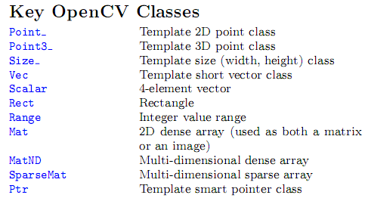
Main Structures

Slide 18
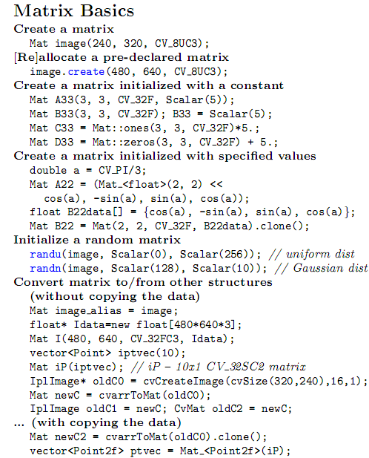
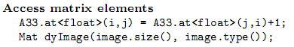
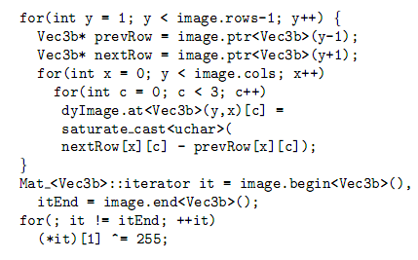
New “Image”: cv::Mat
Mat does reference counting, so it does
the right thing when it goes out of scope
you can also easily make stl vectorts or maps
out of Mat.

Slide 19
Mat are Simple
Mat M(480,640,CV_8UC3); // Make a 640x480 img
Rect roi(100,200, 20,40); // Make a region of int
Mat subM = M(roi); // Take a sub region,
// no copy is done
Mat_<Vec3b>::iterator it= subM.begin<Vec3b>(),
itEnd = subM.end<Vec3b>();
//0 out places in subM where blue > red
for(; it != itEnd; ++it)
if( (*it)[0] > (*it)[2]) (*it)[0] = 0;

Slide 20
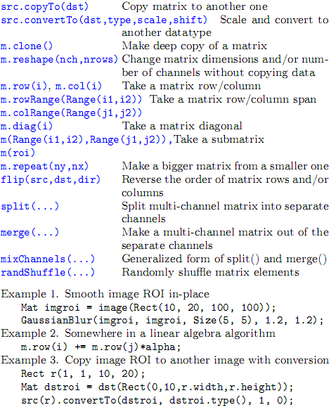
Matrix Manipulation

Slide 21
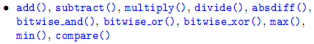



Simple Matrix Operations

Slide 22


Simple Image Processing

Slide 23


Image Conversions

Slide 24

Histogram

Slide 25

I/O

Slide 26


Serialization I/O

Slide 27

Serialization I/O

Slide 28

GUI (“HighGUI”)

Slide 29

Camera Calibration, Pose, Stereo

Slide 30

Object Recognition

Slide 31
samples/c
In ...\opencv\samples\c
bgfg_codebook.cpp - Use of a image value codebook
for background detection for
collecting objects
bgfg_segm.cpp - Use of a background learning engine
blobtrack.cpp - Engine for blob tracking in images
calibration.cpp - Camera Calibration
camshiftdemo.c - Use of meanshift in simple color tracking
contours.c - Demonstrates how to compute and use
object contours
convert_cascade.c - Change the window size in a recognition
cascade
convexhull.c - Find the convex hull of an object
delaunay.c - Triangulate a 2D point cloud
demhist.c - Show how to use histograms for recognition
dft.c - Discrete fourier transform
distrans.c - distance map from edges in an image
drawing.c - Various drawing functions
edge.c - Edge detection
facedetect.c - Face detection by classifier cascade
ffilldemo.c - Flood filling demo
find_obj.cpp - Demo use of SURF features
fitellipse.c - Robust elipse fitting
houghlines.c - Line detection
image.cpp - Shows use of new image class, CvImage();
inpaint.cpp - Texture infill to repair imagery
kalman.c - Kalman filter for trackign
kmeans.c - K-Means
laplace.c - Convolve image with laplacian.
letter_recog.cpp - Example of using machine learning
Boosting,
Backpropagation (MLP) and
Random forests
lkdemo.c - Lukas-Canada optical flow
minarea.c - For a cloud of points in 2D, find min bounding box and circle.
Shows use of Cv_SEQ
morphology.c - Demonstrates Erode, Dilate, Open, Close
motempl.c - Demonstrates motion templates
(orthogonal optical flow given silhouettes)
mushroom.cpp - Demonstrates use of decision trees (CART)
for recognition
pyramid_segmentation.c - Color segmentation in pyramid
squares.c - Uses contour processing to find squares
in an image
stereo_calib.cpp - Stereo calibration, recognition and disparity
map computation
watershed.cpp - Watershed transform demo.

Slide 32

samples/C++

Slide 33


Samples/python

Slide 34
Book Examples
ch2_ex2_1.cpp Load image from disk
ch2_ex2_2.cpp Play video from disk
ch2_ex2_3.cpp Add a slider control
ch2_ex2_4.cpp Load, smooth and dsiplay image
ch2_ex2_5.cpp Pyramid down sampling
ch2_ex2_6.cpp CvCanny edge detection
ch2_ex2_7.cpp Pyramid down and Canny edge
ch2_ex2_8.cpp Above program simplified
ch2_ex2_9.cpp Play video from camera or file
ch2_ex2_10.cpp Read and write video, do Logpolar
ch3_ex3_1.txt Matrix structure
ch3_ex3_2.txt Matrix creation and release
ch3_ex3_3.cpp Create matrix from data list
ch3_ex3_4.cpp Accessing matrix data CV_MAT_ELEM()
ch3_ex3_5.cpp Setting matrix CV_MAT_ELEM_PTR()
ch3_ex3_6.txt Pointer access to matrix data
ch3_ex3_7.txt Image and Matrix Element access functions
ch3_ex3_8.txt Setting matrix or image elements
ch3_ex3_9.cpp Summing all elements in 3 channel matrix
ch3_ex3_10.txt IplImage Header
ch3_ex3_11.cpp Use of widthstep
ch3_ex3_12.cpp Use of image ROI
ch3_ex3_13.cpp Implementing an ROI using widthstep
ch3_ex3_14.cpp Alpha blending example
ch3_ex3_15.cpp Saving and loading a CvMat
ch3_ex3_16.txt File storage demo
ch3_ex3_17.cpp Writing configuration files as XML
ch3_ex3_19.cpp Reading an XML file
ch3_ex3_20.cpp How to check if IPP acceleration is on

Slide 35
Book Examples
ch4_ex4_1.cpp Use a mouse to draw boxes
ch4_ex4_2.cpp Use a trackbar as a button
ch4_ex4_3.cpp Finding the video codec
ch5_ex5_1.cpp Using CvSeq
ch5_ex5_2.cpp cvThreshold example
ch5_ex5_3.cpp Combining image planes
ch5_ex5_4.cpp Adaptive threshiolding
ch6_ex6_1.cpp cvHoughCircles example
ch6_ex6_2.cpp Affine transform
ch6_ex6_3.cpp Perspective transform
ch6_ex6_4.cpp Log-Polar conversion
ch6_ex6_5.cpp 2D Fourier Transform
ch7_ex7_1.cpp Using histograms
ch7_ex7_2.txt Earth Mover’s Distance interface
ch7_ex7_3_expanded.cpp Earth Mover’s Distance set up
ch7_ex7_4.txt Using Earth Mover’s Distance
ch7_ex7_5.cpp Template matching /Cross Corr.
ch7_ex7_5_HistBackProj.cpp Back projection of histograms
ch8_ex8_1.txt CvSeq structure
ch8_ex2.cpp Contour structure
ch8_ex8_2.cpp Finding contours
ch8_ex8_3.cpp Drawing contours

Slide 36
Book Examples
ch9_ex9_1.cpp Sampling from a line in an image
ch9_watershed.cpp Image segmentation using Watershed transform
ch9_AvgBackground.cpp Background model using an average image
ch9_backgroundAVG.cpp Background averaging using a codebook compared to just an average
ch9_backgroundDiff.cpp Use the codebook method for doing background differencing
ch9_ClearStaleCB_Entries.cpp Refine codebook to eliminate stale entries
cv_yuv_codebook.cpp Core code used to design OpenCV codebook
ch10_ex10_1.cpp Optical flow using Lucas-Kanade in an image pyramid
ch10_ex10_1b_Horn_Schunck.cpp Optical flow based on Horn-Schunck block matching
ch10_ex10_2.cpp Kalman filter example code
ch10_motempl.cpp Using motion templates for segmenting motion.
ch11_ex11_1.cpp Camera calibration using automatic chessboard finding using a camera
ch11_ex11_1_fromdisk.cpp Doing the same, but read from disk
ch11_chessboards.txt List of included chessboards for calibration from disk example
ch12_ex12_1.cpp Creating a bird’s eye view of a scene using homography
ch12_ex12_2.cpp Computing the Fundamental matrix using RANSAC
ch12_ex12_3.cpp Stereo calibration, rectification and correspondence
ch12_ex12_4.cpp 2D robust line fitting
ch12_list.txt List of included stereo L+R image pair data
ch13_dtree.cpp Example of using a decision tree
ch13_ex13_1.cpp Using k-means
ch13_ex13_2.cpp Creating and training a decision tree
ch13_ex13_3.cpp Training using statistical boosting
ch13_ex13_4.cpp Face detection using Viola-Jones
cvx_defs.cpp Some defines for use with codebook segmentatio

Slide 37
Python Face Detector Node: 1
The Setup
#!/usr/bin/python
"""
This program is demonstration python ROS Node for face and object detection using haar-like features.
The program finds faces in a camera image or video stream and displays a red box around them. Python implementation by: Roman Stanchak, James Bowman
"""
import roslib
roslib.load_manifest('opencv_tests')
import sys
import os
from optparse import OptionParser
import rospy
import sensor_msgs.msg
from cv_bridge import CvBridge
import cv
# Parameters for haar detection
# From the API:
# The default parameters (scale_factor=2, min_neighbors=3, flags=0) are tuned
# for accurate yet slow object detection. For a faster operation on real video
# images the settings are:
# scale_factor=1.2, min_neighbors=2, flags=CV_HAAR_DO_CANNY_PRUNING,
# min_size=<minimum possible face size
min_size = (20, 20)
image_scale = 2
haar_scale = 1.2
min_neighbors = 2
haar_flags = 0

Slide 38
Python Face Detector Node: 2
The Core
if __name__ == '__main__':
pkgdir = roslib.packages.get_pkg_dir("opencv2")
haarfile = os.path.join(pkgdir, "opencv/share/opencv/haarcascades/haarcascade_frontalface_alt.xml")
parser = OptionParser(usage = "usage: %prog [options] [filename|camera_index]")
parser.add_option("-c", "--cascade", action="store", dest="cascade", type="str", help="Haar cascade file, default %default", default = haarfile)
(options, args) = parser.parse_args()
cascade = cv.Load(options.cascade)
br = CvBridge()
def detect_and_draw(imgmsg):
img = br.imgmsg_to_cv(imgmsg, "bgr8")
# allocate temporary images
gray = cv.CreateImage((img.width,img.height), 8, 1)
small_img = cv.CreateImage((cv.Round(img.width / image_scale),
cv.Round (img.height / image_scale)), 8, 1)
# convert color input image to grayscale
cv.CvtColor(img, gray, cv.CV_BGR2GRAY)
# scale input image for faster processing
cv.Resize(gray, small_img, cv.CV_INTER_LINEAR)
cv.EqualizeHist(small_img, small_img)
if(cascade):
faces = cv.HaarDetectObjects(small_img, cascade, cv.CreateMemStorage(0),
haar_scale, min_neighbors, haar_flags, min_size)
if faces:
for ((x, y, w, h), n) in faces:
# the input to cv.HaarDetectObjects was resized, so scale the
# bounding box of each face and convert it to two CvPoints
pt1 = (int(x * image_scale), int(y * image_scale))
pt2 = (int((x + w) * image_scale), int((y + h) * image_scale))
cv.Rectangle(img, pt1, pt2, cv.RGB(255, 0, 0), 3, 8, 0)
cv.ShowImage("result", img)
cv.WaitKey(6)
rospy.init_node('rosfacedetect')
image_topic = rospy.resolve_name("image")
rospy.Subscriber(image_topic, sensor_msgs.msg.Image, detect_and_draw)
rospy.spin()

Slide 39
Outline
OpenCV Overview
Cheatsheet
Simple Programs
Tour
Features2D
Applications

Slide 40
New C++ API: Usage Example
Focus Detector
C:
C++:
double calcGradients(const IplImage *src, int aperture_size = 7)
{
CvSize sz = cvGetSize(src);
IplImage* img16_x = cvCreateImage( sz, IPL_DEPTH_16S, 1);
IplImage* img16_y = cvCreateImage( sz, IPL_DEPTH_16S, 1);
cvSobel( src, img16_x, 1, 0, aperture_size);
cvSobel( src, img16_y, 0, 1, aperture_size);
IplImage* imgF_x = cvCreateImage( sz, IPL_DEPTH_32F, 1);
IplImage* imgF_y = cvCreateImage( sz, IPL_DEPTH_32F, 1);
cvScale(img16_x, imgF_x);
cvScale(img16_y, imgF_y);
IplImage* magnitude = cvCreateImage( sz, IPL_DEPTH_32F, 1);
cvCartToPolar(imgF_x, imgF_y, magnitude);
double res = cvSum(magnitude).val[0];
cvReleaseImage( &magnitude );
cvReleaseImage(&imgF_x);
cvReleaseImage(&imgF_y);
cvReleaseImage(&img16_x);
cvReleaseImage(&img16_y);
return res;
}
double contrast_measure(const Mat& img)
{
Mat dx, dy;
Sobel(img, dx, 1, 0, 3, CV_32F);
Sobel(img, dy, 0, 1, 3, CV_32F);
magnitude(dx, dy, dx);
return sum(dx)[0];
}

Slide 41
Pyramid
/*
* Make an image pyramid with levels of arbitrary scale reduction (0,1)
* M Input image
* reduction Scaling factor 1>reduction>0
* levels How many levels of pyramid
* pyr std vector containing the pyramid
* sz The width and height of blurring kernel, DEFAULT 3
* sigma The standard deviation of the blurring Gaussian DEFAULT 0.5
* RETURNS Number of levels achieved
*/
int buildGaussianPyramid(const Mat &M, double reduction, int levels,
vector<Mat> &pyr, int sz = 3, float sigma = 0.5)
{
if(M.empty()) return 0;
pyr.clear(); //Clear it up
if((reduction <= 0.0)||(reduction >=1.0)) return 0;
Mat Mblur, Mdown = M;
pyr.push_back(Mdown);
Size ksize = Size(sz,sz);
int L=1;
for(; L<=levels; ++L)
{
if((reduction*Mdown.rows) <= 1.0 || (reduction*Mdown.cols) <= 1.0) break;
GaussianBlur(Mdown,Mblur, ksize, sigma, sigma);
resize(Mblur,Mdown, Size(), reduction, reduction);
pyr.push_back(Mdown);
}
return L;
}

Slide 42
Outline
OpenCV Overview
Cheatsheet
Simple Programs
Tour
Features2D
Applications

Slide 43




Canny Edge Detector
Notes:
43

Slide 44


Distance Transform
Distance field from edges of objects
Flood Filling
44

Slide 45

Hough Transform
Gary Bradski, Adrian Kahler 2008
45

Slide 46


Space Variant vision: Log-Polar Transform
Screen shots by Gary Bradski, 2005
46
Notes:
46

Slide 47

Scale Space
Chart by Gary Bradski, 2005
void cvPyrDown(
IplImage* src,
IplImage* dst,
IplFilter filter = IPL_GAUSSIAN_5x5);
void cvPyrUp(
IplImage* src,
IplImage* dst,
IplFilter filter = IPL_GAUSSIAN_5x5);
47
Notes:
47

Slide 48


Thresholds
Screen shots by Gary Bradski, 2005
48

Slide 49


Histogram Equalization
Screen shots by Gary Bradski, 2005
49

Slide 50

Contours
50

Slide 51
Morphological Operations Examples
Morphology - applying Min-Max. Filters and its combinations
Image I
Erosion IΘB
Dilatation I⊕B
Opening IoB= (IΘB)⊕B
Closing I•B= (I⊕B)ΘB
Grad(I)= (I⊕B)-(IΘB)
TopHat(I)= I - (IΘB)
BlackHat(I)= (I⊕B) - I

Slide 52


Image textures
Inpainting:
Removes damage to images, in this case, it removes the text.

Slide 53

Segmentation
Pyramid, mean-shift, graph-cut
Here: Watershed
Screen shots by Gary Bradski, 2005
53

Slide 54

Recent Algorithms: GrabCut
Graph Cut based segmentation
Images by Gary Bradski, © 2010

Slide 55


Motion Templates (work with James Davies)‏
Object silhouette
Motion history images
Motion history gradients
Motion segmentation algorithm
silhouette
MHI
MHG
Charts by Gary Bradski, 2005
55
Notes:
55

Slide 56


Segmentation, Motion Tracking and Gesture Recognition
Motion
Segmentation
Motion
Segmentation
Pose
Recognition
Gesture
Recognition
Screen shots by Gary Bradski, 2005

Slide 57


New Optical Flow Algorithms
// opencv/samples/c/lkdemo.c
int main(…){
…
CvCapture* capture = <…> ? cvCaptureFromCAM(camera_id) : cvCaptureFromFile(path);
if( !capture ) return -1;
for(;;) {
IplImage* frame=cvQueryFrame(capture);
if(!frame) break;
// … copy and process image
cvCalcOpticalFlowPyrLK( …)
cvShowImage( “LkDemo”, result );
c=cvWaitKey(30); // run at ~20-30fps speed
if(c >= 0) {
// process key
}}
cvReleaseCapture(&capture);}
lkdemo.c, 190 lines
(needs camera to run)

Slide 58

Tracking with CAMSHIFT
Control game with head
Screen shots by Gary Bradski, 2005

Slide 59


Projections
Screen shots by Gary Bradski, 2005

Slide 60


Stereo … Depth from Triangulation
Involved topic, here we will just skim the basic geometry.
Imagine two perfectly aligned image planes:
Depth “Z” and disparity “d” are inversly related:

Slide 61



Stereo
In aligned stereo, depth is from similar triangles:
Problem: Cameras are almost impossible to align
Solution: Mathematically align them:
All: Gary Bradski and Adrian Kaehler: Learning OpenCV

Slide 62


Stereo Rectification
Algorithm steps are shown at right:
Goal:
Each row of the image contains the same world points
“Epipolar constraint”
Result: Epipolar alignment of features:
All: Gary Bradski and Adrian Kaehler: Learning OpenCV

Slide 63
Outline
OpenCV Overview
Cheatsheet
Simple Programs
Tour
Features2D
Applications

Slide 64


Features2d contents
Detection
Description
Matching
Matchers available
BruteForce
FlannBased
BOW
Matches filters
(under construction)
Cross check
Ratio check
Detectors available
SIFT
SURF
FAST
STAR
MSER
HARRIS
GFTT (Good Features To Track)
Descriptors available
SIFT
SURF
Calonder
Ferns
One way

Slide 65
Detector interfaces
class FeatureDetector
{
public:
virtual ~FeatureDetector() {}
// Detect keypoints in an image.
virtual void detect( const Mat& image, vector<KeyPoint>& keypoints,
const Mat& mask=Mat() ) const = 0;
// Detect keypoints in an image set.
void detect( const vector<Mat>& imageCollection,
vector<vector<KeyPoint> >& pointCollection,
const vector<Mat>& masks=vector<Mat>() ) const;
virtual void read( const FileNode& fn ) {}
virtual void write( FileStorage& fs ) const {}
protected:
…
};

Slide 66
Creating a detector
Statically
SurfFeatureDetector detector;
Using class factory
cv::Ptr<FeatureDetector> detector = createFeatureDetector(“SURF”);

Slide 67
Running detector
Mat img = imread( "test.png" );
vector<KeyPoint> keypoints;
SurfFeatureDetector detector;
detector.detect( img, keypoints );

Slide 68
Descriptor interfaces
For descriptors that can be represented as vectors in multidimensional space:
DescriptorExtractor and DescriptorMatcher
More general interface (one way, decision-tree-based descriptors):
GenericDescriptorMatcher

Slide 69
DescriptorExtractor interfaces
class CV_EXPORTS DescriptorExtractor
{
public:
virtual ~DescriptorExtractor() {}
// Compute the descriptors for a set of keypoints in an image.
virtual void compute( const Mat& image, vector<KeyPoint>& keypoints,
Mat& descriptors ) const = 0;
// Compute the descriptors for a keypoints collection detected in image collection.
void compute( const vector<Mat>& imageCollection,
vector<vector<KeyPoint> >& pointCollection,
vector<Mat>& descCollection ) const;
virtual void read( const FileNode& ) {}
virtual void write( FileStorage& ) const {}
virtual int descriptorSize() const = 0;
virtual int descriptorType() const = 0;
protected:
…
};

Slide 70
DescriptorExtractor creating
Statically
SurfDescriptorExtractor descriptorExtractor;
Using class factory
cv::Ptr<DescriptorExtractor> descriptorExtractor = createDescriptorExtractor("SURF");

Slide 71
DescriptorExtractor running
Ptr<FeatureDetector> detector = createFeatureDetector("FAST");
Ptr<DescriptorExtractor> descriptorExtractor = createDescriptorExtractor("SURF");
vector<KeyPoint> keypoints;
detector->detect( img, keypoints );
Mat descriptors;
descriptorExtractor->compute( img, keypoints, descriptors );

Slide 72
DescriptorMatcher interfaces
Two groups of match methods
to match descriptors of image pair
to match descriptors of one image to image set
Each group consists from tree type methods
match()
knnMatch()
radiusMatch()

Slide 73
Matching of image pair
// detecting keypoints
SurfFeatureDetector detector;
vector<KeyPoint> keypoints1, keypoints2;
detector.detect( img1, keypoints1 );
detector.detect( img2, keypoints2 );
// computing descriptors
SurfDescriptorExtractor extractor;
Mat descriptors1, descriptors2;
extractor.compute( img1, keypoints1, descriptors1 );
extractor.compute( img2, keypoints2, descriptors2 );
// matching descriptors
BruteForceMatcher<L2<float> > matcher;
vector<DMatch> matches;
matcher.match( descriptors1, descriptors2, matches );

Slide 74
Visualize keypoints
Mat img_points;
drawKeypoints( img, keypoints, img_points );
namedWindow( “keypoints”, 1 );
imshow( “keypoints”, img_points );
waitKey();
Visualize matches
Mat img_matches;
drawMatches( img1, keypoints1,
img2, keypoints2, img_matches);
namedWindow( “matches”, 1 );
imshow( “matches”, img_matches );
waitKey();

Slide 75
Running the sample
Download OpenCV
Compile
Run matcher_simple:
bin/matcher_simple ../../opencv/samples/c/box.png ../../opencv/samples/c/box_in_scene.png
Select a detector that gives the maximum number of keypoints
Switch SIFT and SURF descriptors

Slide 76
Cross-check outlier match filtering
BruteForceMatcher<L2<float> > descriptorMatcher;
vector<DMatch> filteredMatches12, matches12, matches21;
descriptorMatcher.match( descriptors1, descriptors2, matches12 );
descriptorMatcher.match( descriptors2, descriptors1, matches21 );
for( size_t i = 0; i < matches12.size(); i++ )
{
DMatch forward = matches12[i];
DMatch backward = matches21[forward.trainIdx];
if( backward.trainIdx == forward.queryIdx )
filteredMatches12.push_back( forward );
}

Slide 77
Ratio test to filter matches
(less is better)

Slide 78
Calculating inliers (planar objects case)
Detect keypoints
Find matches using descriptors
Filter matches using cross-check
Calculate best homography
Filter outliers
Run
bin/descriptor_extractor_matcher SURF SURF ../../opencv/samples/c/box.png ../../opencv/samples/c/box_in_scene.png 3
The last parameter is the reprojection threshold for RANSAC

Slide 79
Detector testbench
Measures of detector repeatability are taken from
K.Mikolajczyk, Cordelia Schmid, “Scale & Affine Invariant Interest Point Detectors”, IJCV 60(1), 63–86, 2004.
K.Mikolajczyk et al, A Comparison of Affine Region Detectors, IJCV 65(1/2):43-72, 2005.
Test images are taken from http://www.robots.ox.ac.uk/~vgg/data/data-aff.html
Testbench is located in opencv_extra/testdata/cv/detectors_descriptors_evaluation/detectors

Slide 80
Descriptor testbench
Measures of descriptor matching accuracy are taken from
http://www.robots.ox.ac.uk/~vgg/research/affine/det_eval_files/mikolajczyk_pami2004.pdf
Test images are taken from http://www.robots.ox.ac.uk/~vgg/data/data-aff.html
Testbench is located in opencv_extra/testdata/cv/detectors_descriptors_evaluation/descriptors

Slide 81
OpenCV and ROS
Opencv2 package to fetch and compile opencv
Messages:
sensor_msgs::Image
sensor_msgs::CameraInfo
cv_bridge to convert between messages and images
image_geometry::PinholeCameraModel and image_geometry::StereoCameraModel to manage 2d <-> 3d conversions

Slide 82
Q&A
Foils will be available at http://itseez.com

